Slide 1
@AtlCodeCamp
httpS://AtlantaCodeCamp.com/2016
@JeremyLikness
Ng1 → Ng2

Slide 2




Platinum Sponsors

Slide 3







Gold Sponsors

Slide 4





SWAG Sponsors
Silver Sponsors

Slide 5
Surveys and Prizes
Please complete the session and event surveys!
1 ticket per session survey
1 ticket for the event survey
1 ticket for completing the booth game
Drawing for prizes begins at 5pm in Q202

Slide 6





About iVision
About iVision
A privately held, IT consulting firm headquartered in Midtown, Atlanta.
At iVision, we seek to understand our clients’ business first. We work with clients to architect, transform and support their technology — enabling them to realize their vision of a better tomorrow.
The iVision Difference
Engineering Expertise
White Glove Service
Delivery Assurance
Flexible Business Model
Proven Partner Ecosystem
Culture & People
Jeremy Likness| Director of App Dev
https://github.com/JeremyLikness
http://bit.ly/coderblog

Slide 7
Today’s Menu
Angular 1.x
$scope
Controller as
Components
Angular 2.x
TypeScript
ngUpgrade
Q & A

Slide 8
DEMO
The Flavors of Ng1 and pure Ng2
https://github.com/JeremyLikness/Back2NgFuture/

Slide 9
TypeScript
All JavaScript *is* TypeScript
Learn how to declare module definitions
Use a module loader
Convert to classes
Add annotations
Consider the Angular-CLI (http://bit.ly/ngclidocs)

Slide 10
DEMO
TypeScript Code

Slide 11
ngUpgrade
When “All or Nothing” won’t cut it

Slide 12
Components: NG1 from the Top, then Children Switch
NG1
NG2
NG1
NG2
NG2
NG1
NG1

Slide 13
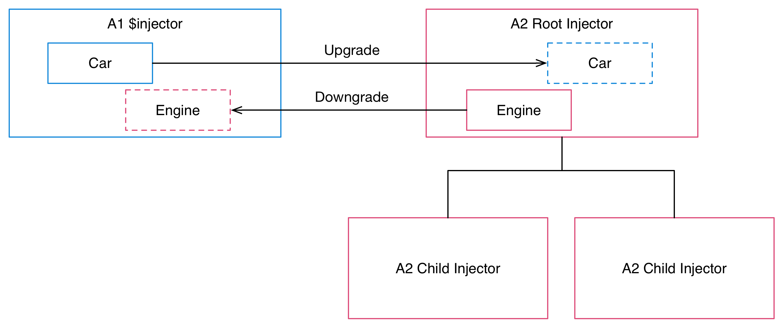
Injectors: Up and Down, and All Around
Source: https://angular.io/docs/

Slide 14
Steps
JavaScript
Remove ng-app or Angular 1 bootstrap code
Include Angular 2 libraries, including the upgrade library
Bootstrap with the upgrade adapter
Begin migrating components and services
Finally, remove Angular 1 and upgrade references and run directly
TypeScript
Organize into TypeScript files
Configure compiler workflow
Choose module loader

Slide 15
Caveats (There always are some, no?)
1.5 Components
Elements
Isolated Scope
Bind to controller, not $scope
Own controller and templates
Not Compatible:
compile
replace: true
priority/terminal (ignored)
Angular 2 use Angular 2 binding syntax even when downgraded
For Angular 1 templates, use kebab-case not camelCase!
Project ng1 into ng2 with ng-content in template
Transclude ng2 into ng1 with ng-transclude in template

Slide 16
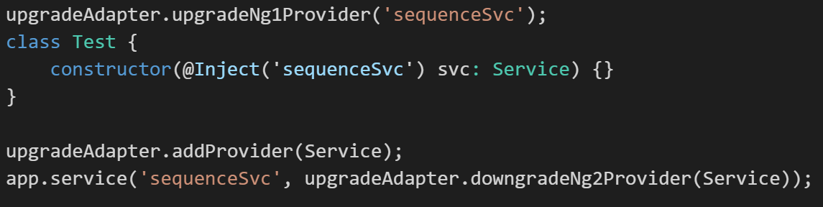
Quick Note on Services
upgradeNg1Provider(‘name’)
addProvider(type)
downgradeNg2Provider(type)

Slide 17
DEMO
Putting it all together

Slide 18
Questions?
@JeremyLikness
Jeremy Likness| Director of App Dev
https://github.com/JeremyLikness
http://bit.ly/coderblog

